Slide 1
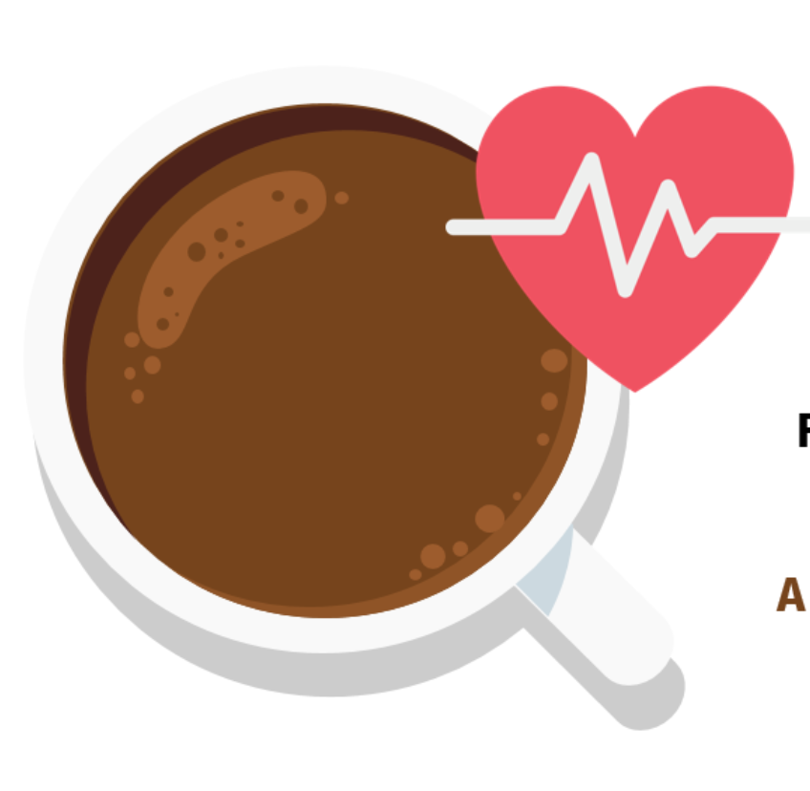
Coffee Consumption & Cardiovascular Health:
An Exploratory Data Analysis Project
Aina Bukola Akanbi, Adeleke Abraham, Kang Kate, Mannan Suzana, Ndang Clovis, Ukueku Benjamin

Slide 2
Context & Purpose
Coffee is one of the most widely consumed beverages in the world, woven into daily routines for energy, focus, and comfort.
Mayo Family Health Clinic (MFHC) aims to better understand this connection as part of its commitment to preventive, research-informed care.
By examining lifestyle and clinical data, our team explored how coffee consumption relates to indicators such as heart rate, BMI, stress, and sleep.
The purpose of this project is to deliver clear, evidence-based insights that support practitioner counseling, promote heart-healthy habits, and guide MFHC’s ongoing preventive-care initiatives.
Notes:
introduce what are presentation topic is about

Slide 3
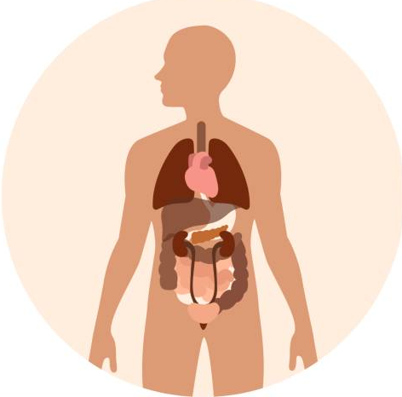
Audience Overview
Mayo Family Health Clinic (MFHC), a clinic dedicated to research-informed, patient-centered healthcare.
Improving patient education and addressing common clinical questions around caffeine.
01
06
Use lifestyle and clinical datasets to identify patterns, correlations, and risk indicators
Healthcare practitioners at MFHC
02
05
Understanding lifestyle factors like caffeine intake for comprehensive cardiovascular risk assessment.
Support practitioner decision-making when discussing caffeine and heart health with patients.
03
04
Notes:
this is where in each point we mention who are audience is, what clinic, key points like values

Slide 4
Dictionary
Term | Definition
Mayo Family Health Clinic | Healthcare centre in Minnesota, USA.
BMI (Body Mass Index) | A measurement that uses a person's height and weight to determine if their body weight is healthy.
Blood Pressure | The pressure exerted by circulating blood on the walls of blood vessels.
Cardiovascular Disease | A groups of medical conditions that affect the heart's normal function. E.g. Heart attack
At-Risk Individual | A person who has a higher likelihood of developing a certain health issue.
Logistic Regression | A statistical technique used to predict the chance of an event occurring.

Slide 5
"Do healthcare practitioners need to consider caffeine intake for cardiovascular health or is it clinically insignificant?"
OVERARCHING GOAL
Notes:
What did we want to find out from this analysis?

Slide 6
Data Sets Overview
Heart Dataset
heart.csv
Coffee Dataset
synthetic_coffee_health_10000.csv
Provided by Kaggle

Slide 7
Dataset Breakdown
Data Cleansing
STEP 1
STEP 2
STEP 3
STEP 4
Import & Inspect the Raw Data
Imported dataset
Viewed sample rows with .head()
Checked dataset structure using .info()
Handle Missing Data & Structural Issues
Identified column with missing values
Dropped the unnecessary columns
Performed a final missing-value check
Clean & Transform
Converted categorical features
Detect outliers
Performed anomaly checks
Aggregate columns
Summarize & Export Cleaned Data
Calculated mean heart rate by Coffee_Level and Gender
Exported the cleaned dataset
Notes:
Pick 4 main steps we completed in cleaning the data.. Reminder this is being presented to "physicians" so we need to make it simple and straight to point because our audience is not "data" students

Slide 8
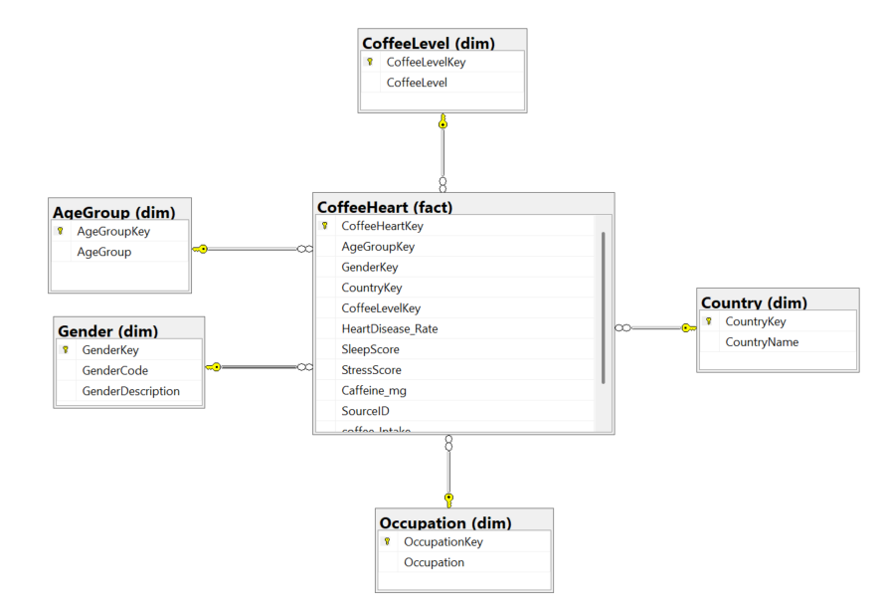
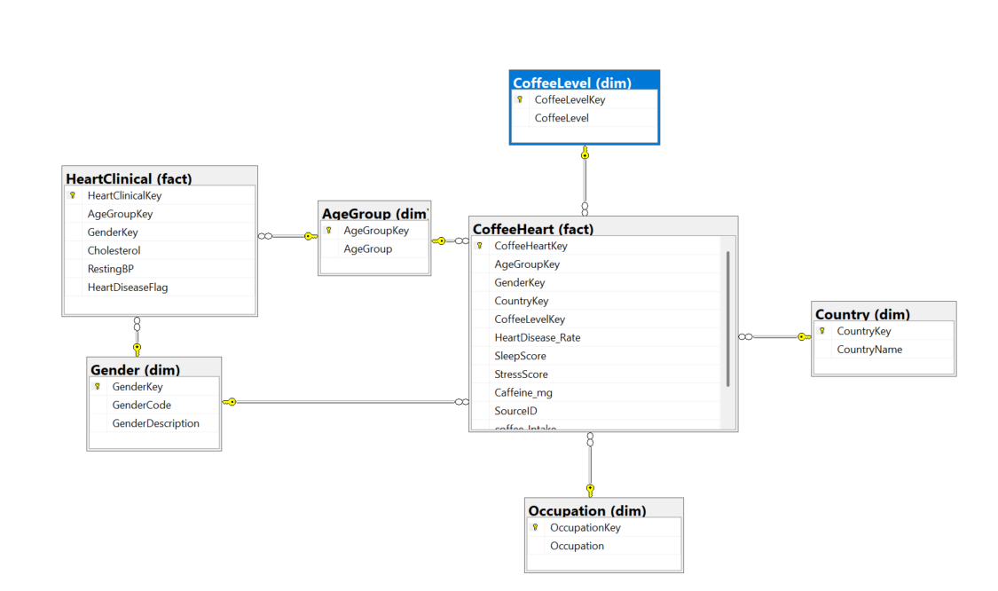
STAR SCHEMA
One Fact table surrounded by dimension tables
GALAXY SCHEMA
Two Fact tables that share conformed dimension tables
Notes:
Star schema of all the visual

Slide 9
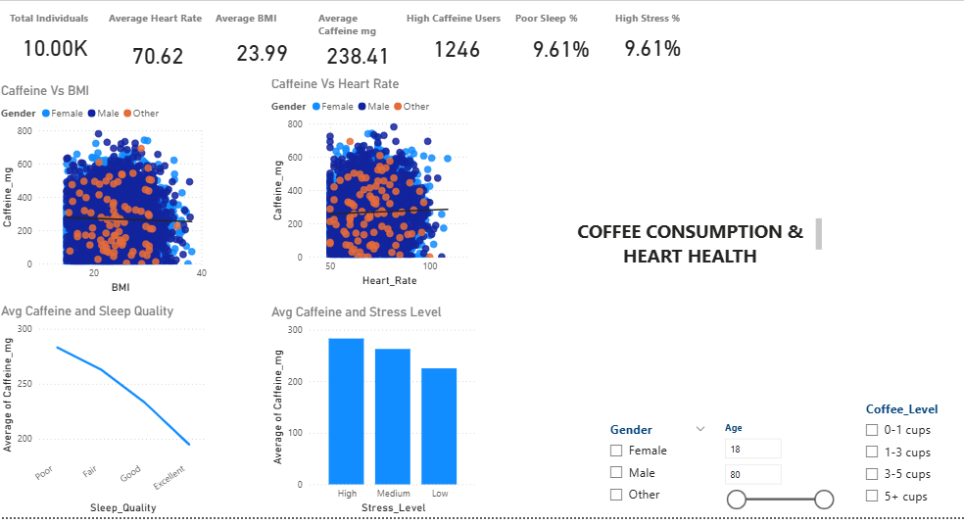
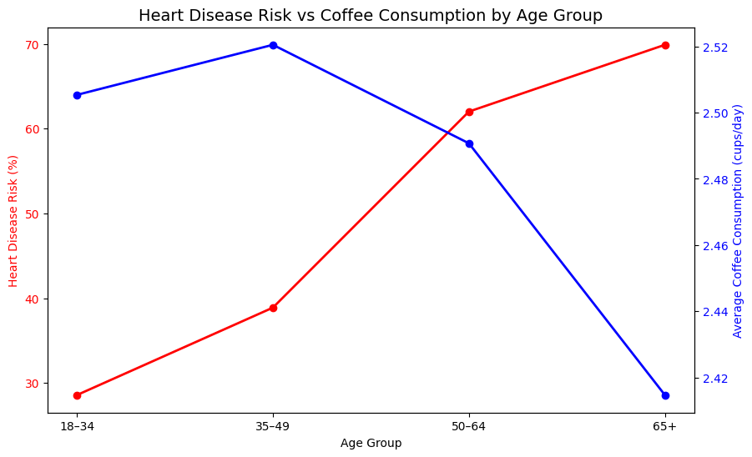
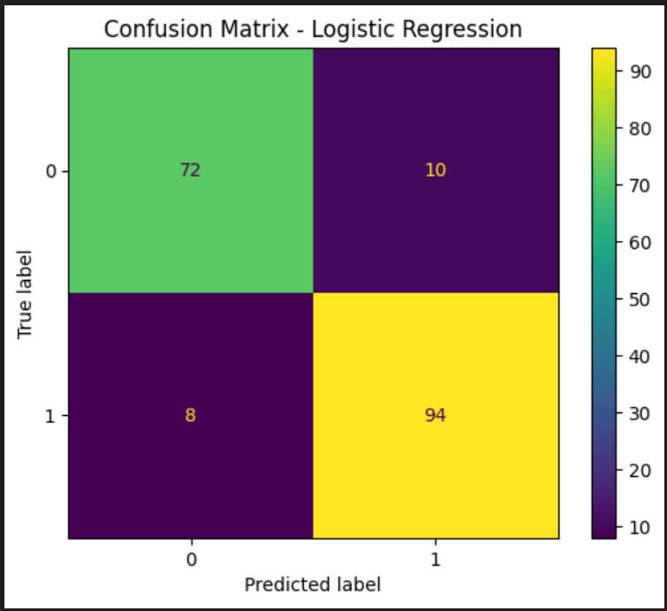
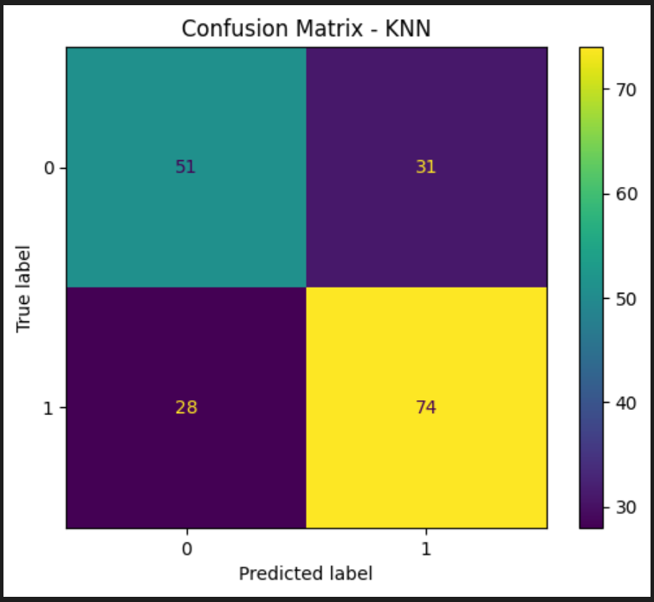
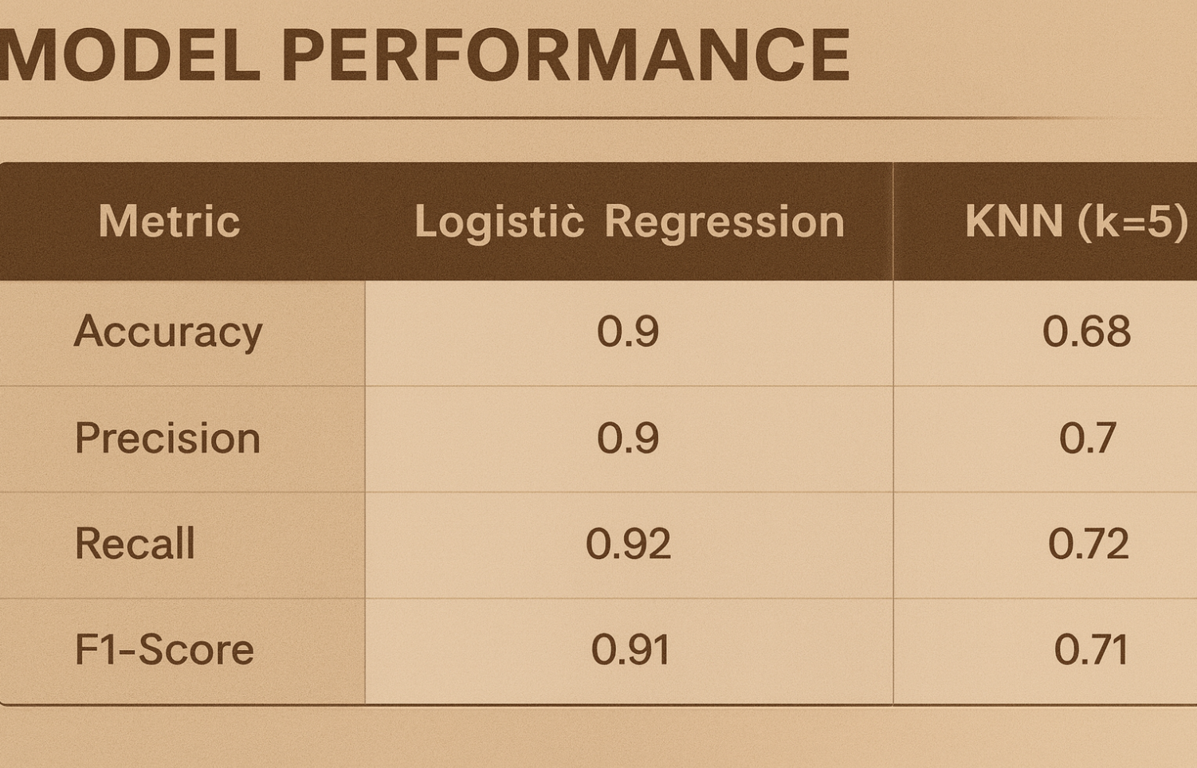
TOTAL INDIVIDUALS 10K | AVG HEART RATE 70.62 | AVG BMI 23.99 | AVG CAFFEINE INTAKE 238 mg | POOR SLEEP % 9.61

Slide 10
Business Question
QUESTION 1
“To what extent does coffee (caffeine) consumption relate to cardiovascular-related indicators such as heart rate, BMI, sleep, and stress_Score/ levels in the lifestyle dataset?”
Correlation
Regression
Visual & Deeper Explanation
INSIGHTS
Notes:
Intro business question 3

Slide 11
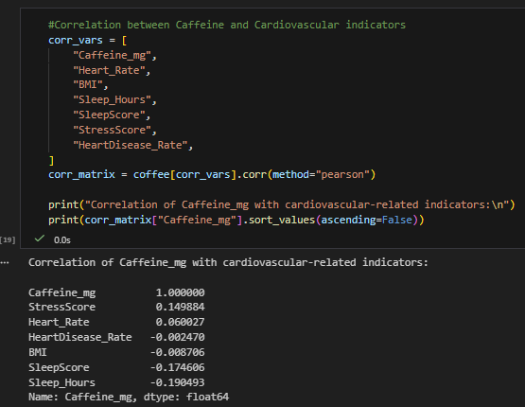
Caffeine vs StressScore
Correlation = +0.15 (weak positive)
Caffeine vs Heart Rate
Correlation = +0.06 (very weak positive)
Caffeine vs BMI
Correlation = +0.009 (no relationship)
Caffeine vs Sleep Hours
Correlation = –0.19 (weak-to-moderate negative)

Slide 12
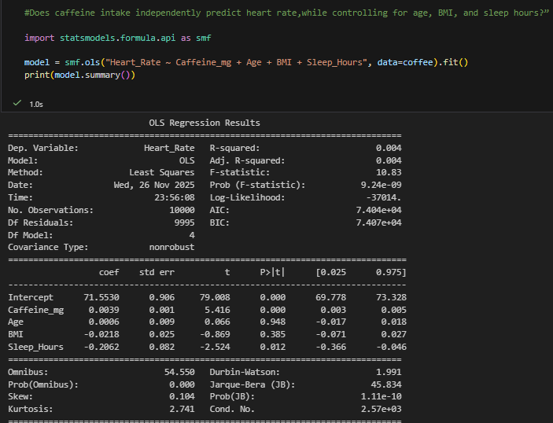
R-Squared....0.004
Coefficient...0.0039
P-value....<0.001

Slide 13
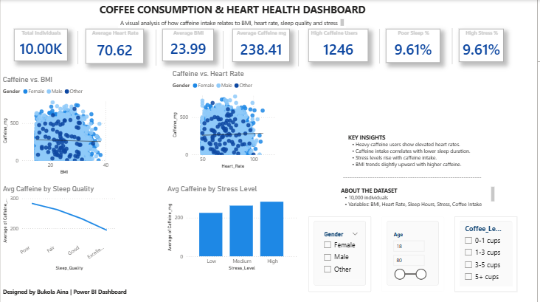
Exploratory Data Analysis (EDA)
-66e36457c834&fromEntryPoint=export

Slide 14

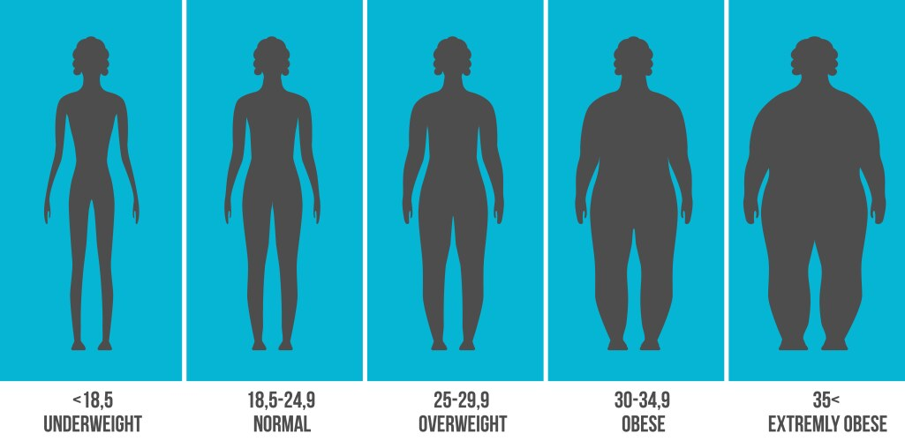


Coffee Consumption & Cardiovascular Indicators
STRESS
High-stress individuals tend to consume more caffeine.​
Possible cycle:
stress ↑
caffeine ↑
sleep ↓
BMI (Body Mass Index)
No relationship between caffeine intake and BMI
Weight patterns influenced more by lifestyle and metabolism than caffeine.
SLEEP QUALITY
Clear negative trend: more caffeine → poorer sleep.
Strongest association in the dataset.
HEART RATE
No clinically meaningful change in resting heart rate as caffeine intake increased.
Notes:
Star schema of all the visual

Slide 15



What this means for patient care
3. Support Lifestyle Conversations
Use charts to guide discussions on sleep hygiene.
Recommend timing caffeine earlier in the day for sensitive patients.
Reassurance for patients
Moderate coffee intake does not significantly affect heart rate or BMI.
Good for reducing unnecessary patient anxiety around coffee habits.
2. Identify At-Risk Groups
Poor sleepers / insomnia cases
High stress or anxiety
Those drinking 3+ cups/day
Notes:
Star schema of all the visual

Slide 16

Insights
How This Supports Mayo Family Health Clinic:
Clinical Value
Enables evidence-based counseling.
Helps clinicians target patients who would benefit most from caffeine reduction.
Future Opportunities
Explore caffeine’s effect on patients with diagnosed heart conditions.
Assess whether improved sleep reduces cardiovascular complaints.
Identify subgroups who are uniquely sensitive to caffeine.
Bottom Line Caffeine is not a universal problem — but for patients with sleep issues or high stress, reducing intake may improve wellbeing.
Notes:
Summary of findings from visual

Slide 17
Business Question
QUESTION 2
“How do age groups differ in heart disease risk, and how do these risks patterns compare with age-specific coffee consumption patterns?”
Notes:
Intro business question 2

Slide 18
Exploratory Data Analysis (EDA)
Notes:
Visual

Slide 19
Insights
Heart disease risk rises consistently with age, reaching its highest level in the 65+ group.
Coffee consumption peaks in midlife and then declines for older age groups.
Older adults have the highest heart disease risk but the lowest coffee consumption, suggesting lifestyle or health-driven changes with age.
The two trends do not correlate positively, and their strongest contrast appears in the 50–64 age group.
Notes:
Summary of findings from visual

Slide 20
Business Question
QUESTION 3
“Can we build a predictive model that helps practitioners identify patients at higher risk of heart failure?”
Notes:
Intro business question 3

Slide 21
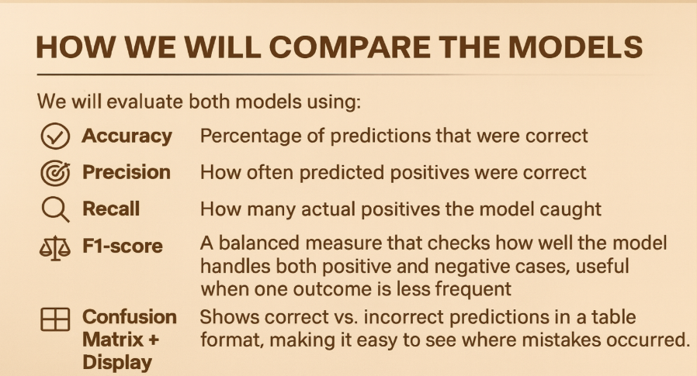
Comparing these metrics ensures the most reliable model for early heart disease detection.

Slide 22
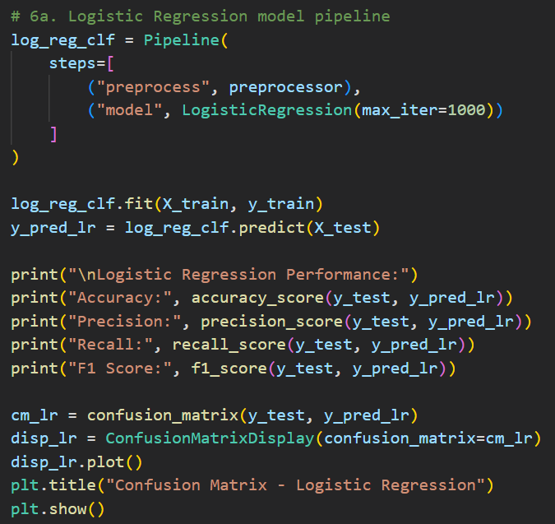
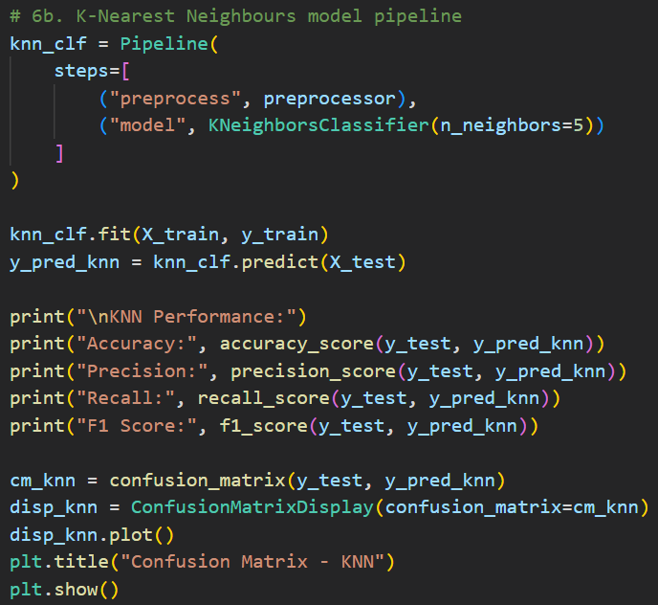
Predictive Modeling
Logistic Regression K-Nearest Neighbors
Notes:
Visual

Slide 23
Correctly predicted heart disease about 90% of the time and showed a strong balance between catching actual cases (recall) and making correct positive predictions (precision).
It correctly predicted heart disease only 68% of the time. Less reliable and less consistent for this clinical problem.
Notes:
Logistic Regression
It performed very well. It correctly predicted heart disease about 90% of the time and showed a strong balance between catching actual cases (recall) and making correct positive predictions (precision).
KNN
It performed significantly worse than Logistic Regression. It correctly predicted heart disease only 68% of the time. While it still learned some patterns, it is less reliable and less consistent for this type of clinical problem.

Slide 24
Evaluation Metric: Confusion Matrix
Notes:
Logistic Regression
It correctly identified 94 patients with heart disease (true positives) and correctly recognized 72 patients without the condition (true negatives). The model made relatively few mistakes, producing only 10 false positives where it predicted heart disease for patients who did not have it and just 8 false negatives, where it missed actual cases. This low number of false negatives is especially important in healthcare because missing real heart-disease patients can delay treatment. Overall, the confusion matrix demonstrates that Logistic Regression is highly accurate and dependable for supporting early risk identification.
KNN
It correctly detected 74 true heart-disease cases and 51 non–heart-disease cases, but it also produced a high number of errors. The model generated 31 false positives and, more concerning, 28 false negatives meaning it missed many patients who actually had heart disease. This makes the model less reliable in a clinical context, where failing to identify high-risk individuals can have serious consequences. The confusion matrix clearly shows that KNN struggles to balance correct predictions and mistakes, making it a less suitable choice for medical decision support.

Slide 25
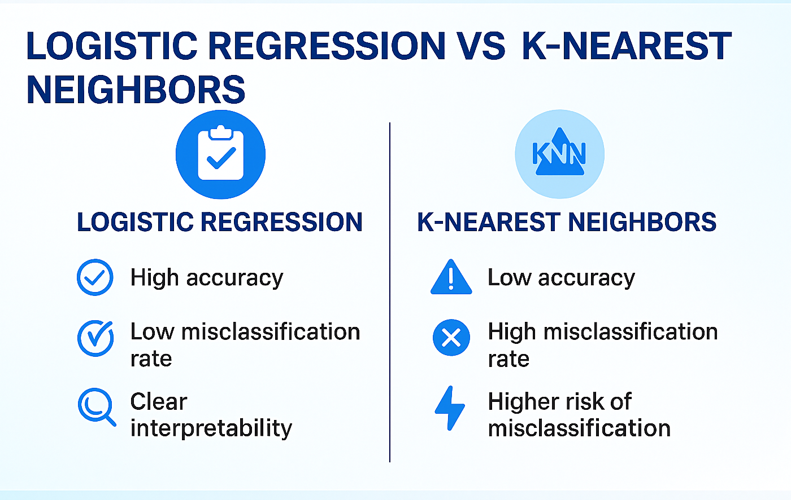
Insights
Notes:
Based on our analysis of the clinical heart-disease dataset, we developed and compared two predictive models (Logistic Regression and K-Nearest Neighbours) to determine which approach provides the most reliable support for identifying patients at higher risk of heart disease. The Logistic Regression model showed strong performance, correctly identifying most patients with heart disease (94 true positives) and most without the condition (72 true negatives). It also produced very few errors, with only 8 missed cases (false negatives) and 10 incorrect alerts (false positives). This resulted in an overall accuracy of 90% and an F1-score of 0.91, demonstrating a strong balance between catching actual cases (recall) and making correct positive predictions (precision).
In contrast, the KNN model was less consistent and less dependable. It missed a much larger number of real heart-disease cases (28 false negatives) and incorrectly flagged many healthy patients (31 false positives). It correctly predicted heart disease only 68% of the time. and an F1-score of 0.71 demonstrating a weaker balance between catching actual cases (recall) and making correct positive predictions (precision). KNN showed weaker predictive ability and higher risk of clinical misclassification.

Slide 26
Question 3 Conclusion
Choose Logistic Regression
High accuracy, low errors
Easy for physicians to interpret
Supports preventive care
Helps early risk detection
Provides clear, data-driven insights
Notes:
Summary of findings from visual
Given these findings, we recommend using Logistic Regression as the primary model for early cardiovascular risk identification at Mayo Clinic. Its high accuracy, low misclassification rate, and clear interpretability make it a safer and more practical option for supporting physicians during patient consultations. This model can enhance preventive-care discussions, help prioritize early monitoring, and provide data-driven insights that align with the clinic’s commitment to improving patient education and community heart-health outcomes.
Overall, the analysis demonstrates that Logistic Regression is the more effective and trustworthy decision-support tool for the clinic’s needs.

Slide 27

FINAL INSIGHTS
"...this study aims to inform healthcare practitioners, whether caffeine intake should be considered in cardiovascular health discussions with patients or is unlikely to be clinically significant."
Answer:
Caffeine intake should be discussed, but it is not a clinically direct risk factor for cardiovascular disease.

